Slide 1


Stefan Straver
10-05-2022

Slide 2

Outline
Executive Summary
Introduction
Methodology
Results
Conclusion
Appendix

Slide 3
Executive Summary
Summary of methodologies
Data Collection with API
Data Collection with Web Scraping
Data Wrangling
Exploratory Data Analysis with SQL
Exploratory Data Analysis with Data Visualization
Interactive Visual Analytics with Folium and Dashboard
Machine Learning Prediction
Summary of all results
Exploratory Data Analysis result
Interactive Analytics with explenatory screenshots
Predictive Analytics result

Slide 4
Introduction
Project background and context
SpaceX reuse the first stage of the rocket. This results in a cost of 62 million instead of the 165 million that other providers have. If we can determine if the first stage of a rocket successfully lands, we can determine what the cost will be of the launch.
Problems you want to find answers
1. What are the variables that determine if a rocket successfully lands?
2. What is the interaction between those variables?
3. What are the operating conditions to have a successful landing?

Slide 5

Section 1

Slide 6
Methodology
Executive Summary
Data collection methodology:
Describe how data was collected
Perform data wrangling
Describe how data was processed
Perform exploratory data analysis (EDA) using visualization and SQL
Perform interactive visual analytics using Folium and Plotly Dash
Perform predictive analysis using classification models
How to build, tune, evaluate classification models

Slide 7
Data Collection
The data was collected with different methods
SpaceX API
Normalised the .json file
Cleaned the data
Web Scraping Wikipedia
HTML table
Converted to pandas frame

Slide 8
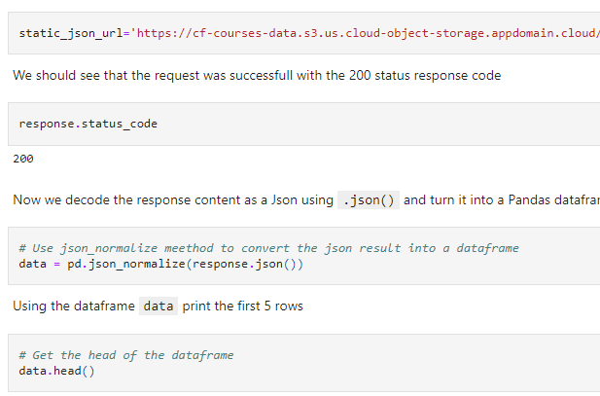
Data Collection – SpaceX API
We collected the data with the SpaceX API and did some cleaning to the data. With wrangling and formatting.
Link to GitHub notebook is:
https://github.com/Stefanstraver/Capstone-Project/blob/master/jupyter-labs-spacex-data-collection-api.ipynb

Slide 9
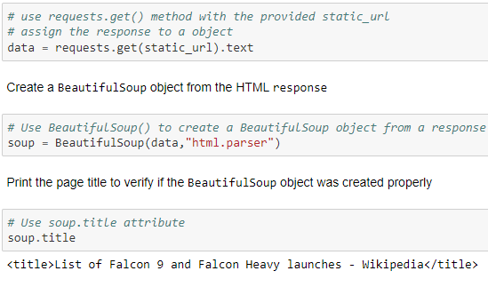
Data Collection - Scraping
We used BeautifulSoup to webscrape the information from wikipedia. Then we parsed the table and changed it into a pandas table.
Link to GitHub notebook is:
https://github.com/Stefanstraver/Capstone-Project/blob/main/jupyter-labs-webscraping%20(1).ipynb

Slide 10
Data Wrangling
Exploratory Analysis
Calculated nr. of launches at each site
Calculated the nr. occurence of orbits
Label for landing outcome
Link to GitHub notebook is:
https://github.com/Stefanstraver/Capstone-Project/blob/main/labs-jupyter-spacex-data-wrangling.ipynb

Slide 11
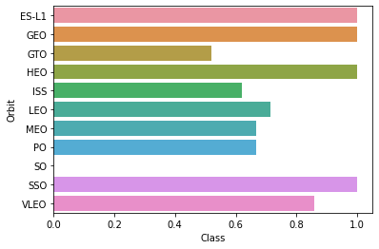
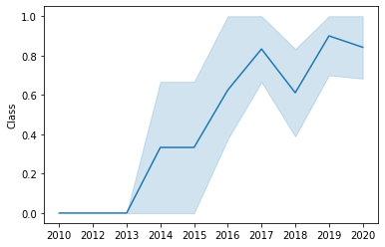
EDA with Data Visualization
We explored the data by visualizing the relationship of:
Flight number vs launch Site
Payload vs Launch site
Success rate of each orbit type
Flight number vs Orbit type
The launch success vs Year
Link to GitHub notebook is:
https://github.com/Stefanstraver/Capstone-Project/blob/main/jupyter-labs-eda-dataviz%20(1).ipynb

Slide 12
EDA with SQL
We requested the follow data with SQL:
Names of unique launch sites
Total payload mass carried by boosters
Average payload mass carried by F9 v1.1
Total of successful and failed missions
The failed landing outcomes in drone ship, their booster version and launch site names
Link to GitHub notebook is:
https://github.com/Stefanstraver/Capstone-Project/blob/main/jupyter-labs-eda-sql-coursera%20(1).ipynb

Slide 13
Build an Interactive Map with Folium
We marked all launch sites, and added map objects such as markers, circles, lines to mark the success or failure of launches for each site on the folium map.
We assigned the feature launch outcomes to failure and success.
Using the color-labeled marker clusters, we identified which launch sites have relatively high success rate.
We calculated the distances between a launch site to its proximities.
Link to GitHub notebook is:
https://github.com/Stefanstraver/Capstone-Project/blob/main/lab-jupyter-launch-site-location.ipynb

Slide 14
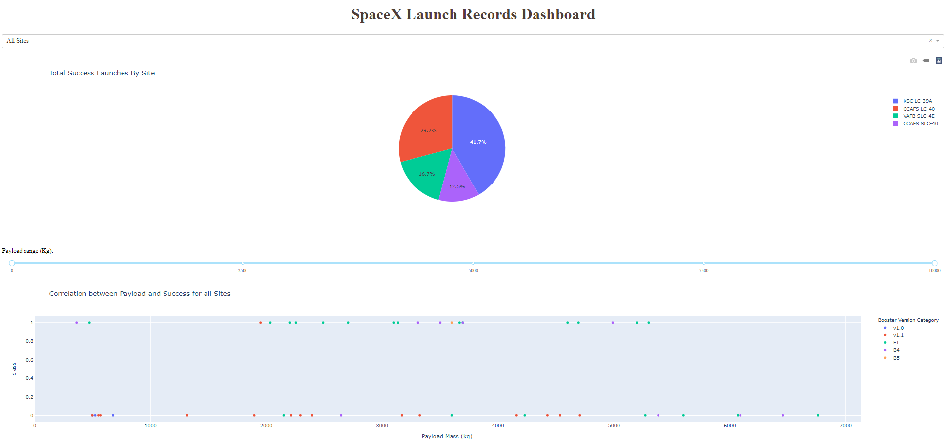
Build a Dashboard with Plotly Dash
We built an interactive Dashboard
We plotted:
Pie Chart with total launches at sites
Scatter Graph with outcome vs payload mass
Link to GitHub notebook is:
Made in skills network labs, so there is not a link in the GitHub project.

Slide 15
Predictive Analysis (Classification)
Transformed the data
Split the data in training and testing
Built machine learning models
Use GridSearchCV to find best performing model
Logistic Regression
SVM
Decision Tree
K-Nearest Neighbour
Link to GitHub notebook is:
https://github.com/Stefanstraver/Capstone-Project/blob/main/spacex-machine-learning-prediction-part-5.ipynb

Slide 16
Results
Exploratory data analysis results
Interactive analytics demo in screenshots
Predictive analysis results

Slide 17

Section 2

Slide 18
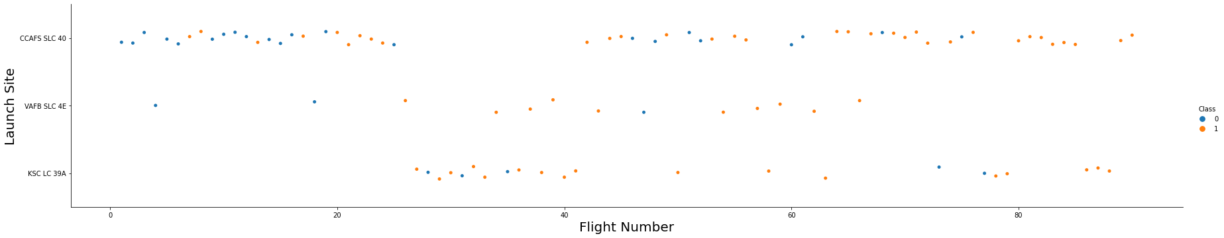
Flight Number vs. Launch Site
We see with each Launch Site that the latest flights were a success. There were more flights with the CCAFS SLC 40 and in the beginning (+- 25 try's) they mostly used this type.

Slide 19
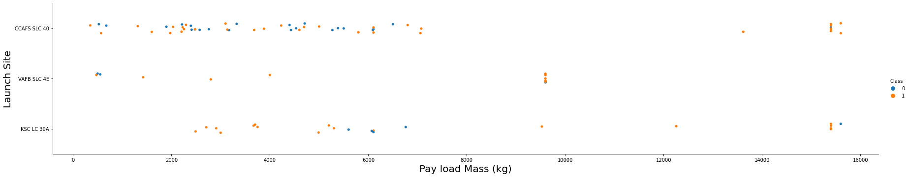
Payload vs. Launch Site
Now if you observe Payload Vs. Launch Site scatter point chart you will find for the VAFB-SLC launchsite there are no rockets launched for heavypayload mass(greater than 10000).

Slide 20
Success Rate vs. Orbit Type
Highest succes rates are:
ES-L1
GEO
HEO
SSO

Slide 21
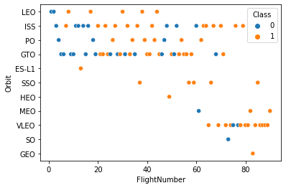
Flight Number vs. Orbit Type
You should see that in the LEO orbit the Success appears related to the number of flights; on the other hand, there seems to be no relationship between flight number when in GTO orbit.

Slide 22
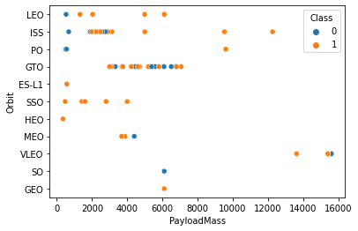
Payload vs. Orbit Type
With heavy payloads the successful landing or positive landing rate are more for Polar,LEO and ISS.
However for GTO we cannot distinguish this well as both positive landing rate and negative landing(unsuccessful mission) are both there here.

Slide 23
Launch Success Yearly Trend
You can observe that the sucess rate since 2013 kept increasing till 2020

Slide 24
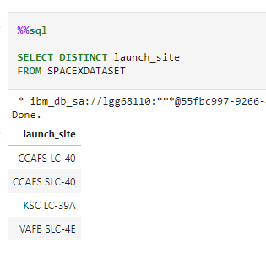
All Launch Site Names

Slide 25
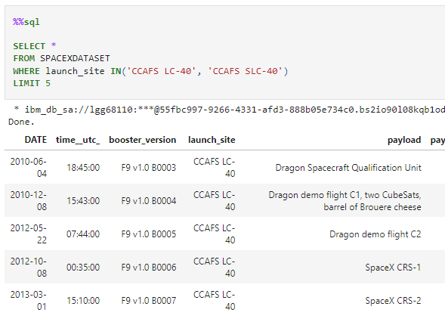
Launch Site Names Begin with 'CCA'

Slide 26
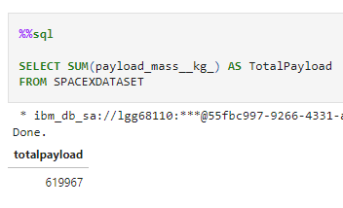
Total Payload Mass
The total payload is 619967kg

Slide 27
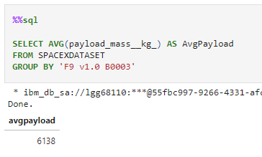
Average Payload Mass by F9 v1.1
The average payload mass carried by booster version F9 v1.1 is 6138kg

Slide 28
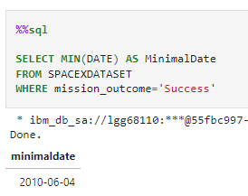
First Successful Ground Landing Date
The date of the first successful landing outcome on ground pad is 04-06-2010

Slide 29
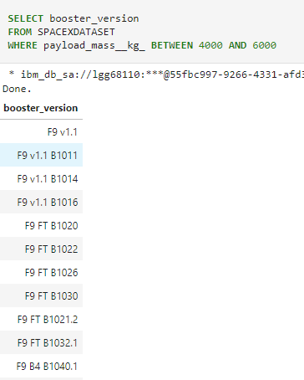
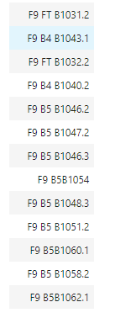
Successful Drone Ship Landing with Payload between 4000 and 6000
The names of boosters which have successfully landed on drone ship and had payload mass greater than 4000 but less than 6000

Slide 30
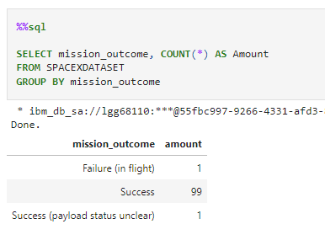
Total Number of Successful and Failure Mission Outcomes
The total number of successful and failure mission outcomes

Slide 31
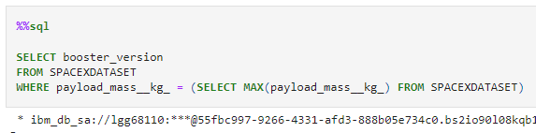
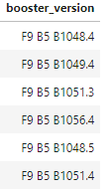
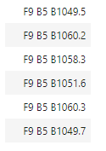
Boosters Carried Maximum Payload
The names of the booster which have carried the maximum payload mass

Slide 32

2015 Launch Records
The failed landing_outcomes in drone ship, their booster versions, and launch site names for in year 2015

Slide 33

Rank Landing Outcomes Between 2010-06-04 and 2017-03-20
The rank count of landing outcomes (such as Failure (drone ship) or Success (ground pad)) between the date 2010-06-04 and 2017-03-20, in descending order

Slide 34

Section 3

Slide 35
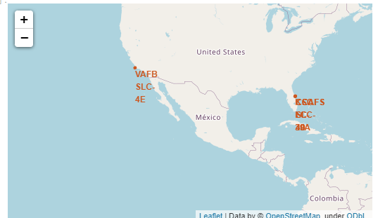
Locations of the launchsites
All launch sites are close to the coast.
Most of them are located at the east coast.

Slide 36

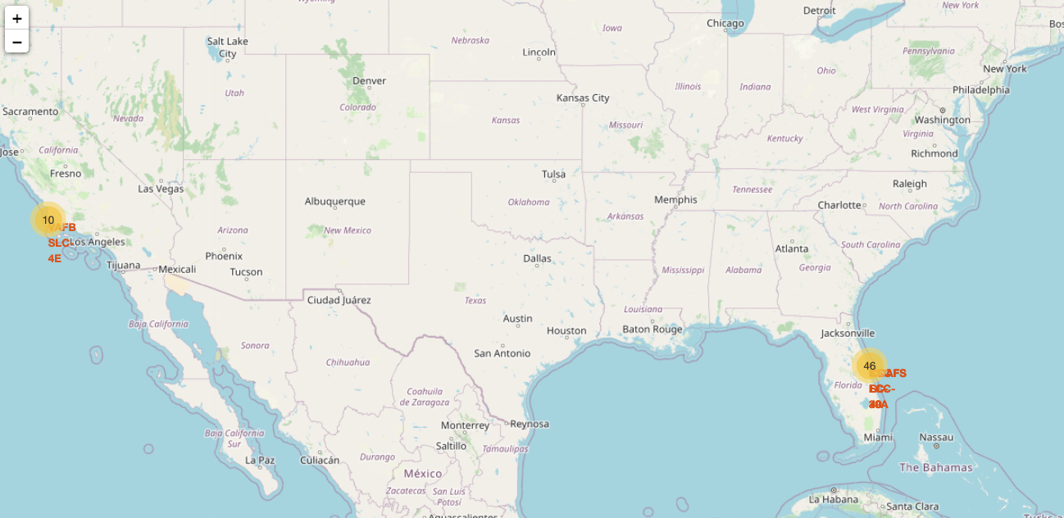
Amount and status of the success
The Green markers show success
The Red markes show not a success

Slide 37

Distance to landmarks in the area

Slide 38

Section 4

Slide 39
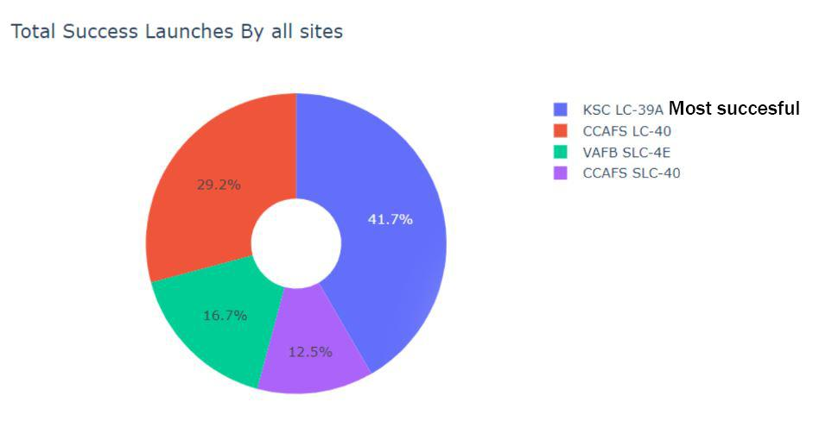
The pie chart with total success launches

Slide 40
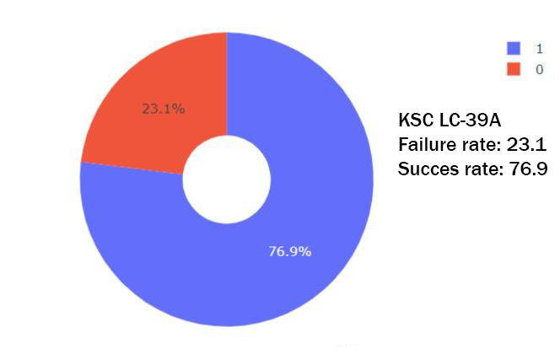
The pie chart of KSC LC-39A

Slide 41
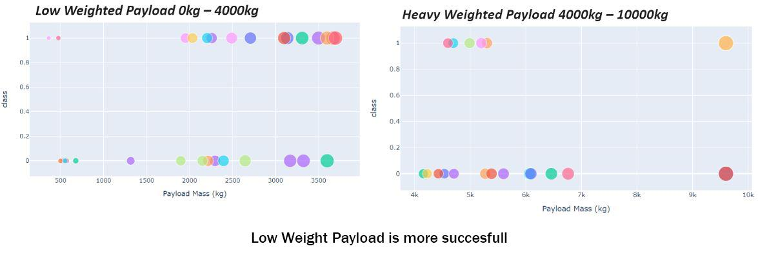
The scatter plot, Low weight and Heavy weight

Slide 42

Section 5

Slide 43
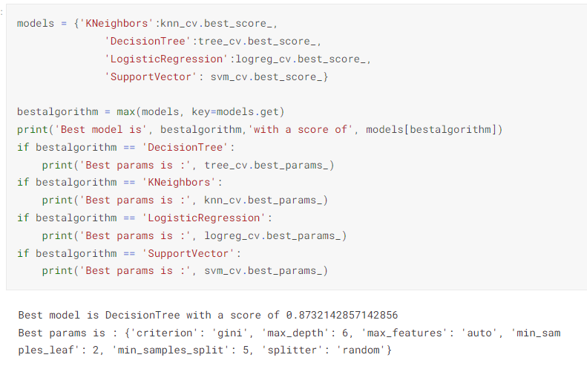
Classification Accuracy
Model with the highest accuracy is DecisionTree with a score of 0.8732

Slide 44
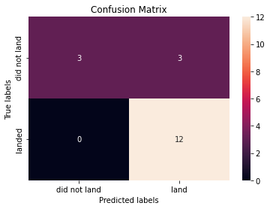
Confusion Matrix
The challenge is the false positive. This means that the the model predicts that the ship will land, but instead it didn’t land.
You can find this in the top right corner.

Slide 45
Conclusions
The larger the flight amount at a launch site, the greater the success rate at a launch site.
Launch success rate started to increase in 2013.
Most successful Orbits are: ES-L1, GEO, HEO, SSO, VLEO.
KSC LC-39A had the most successful launches
Model with the highest accuracy is DecisionTree with a score of 0.8732

Slide 46


